Slide 1
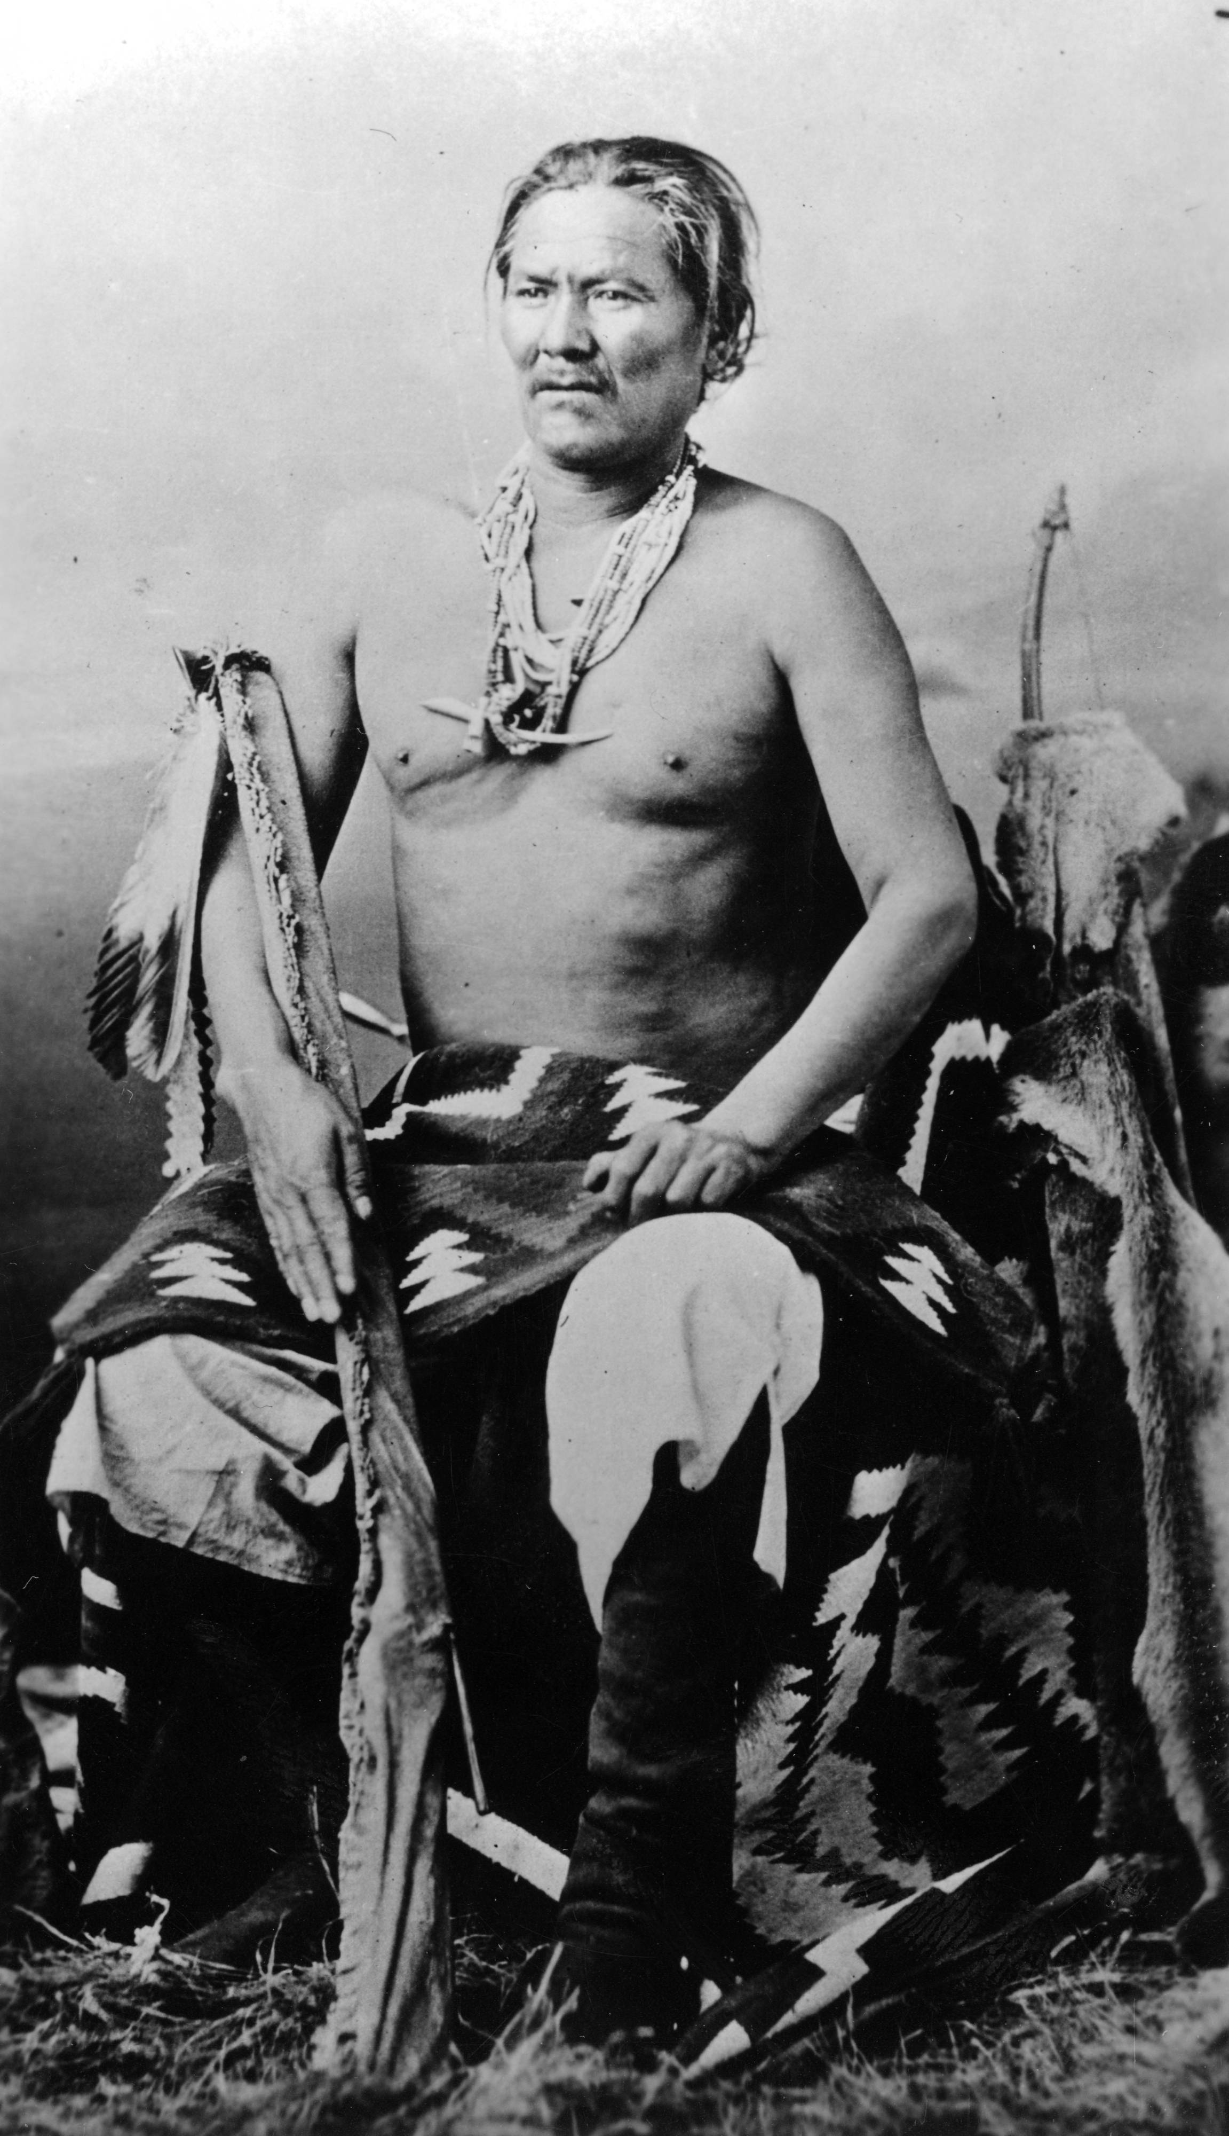
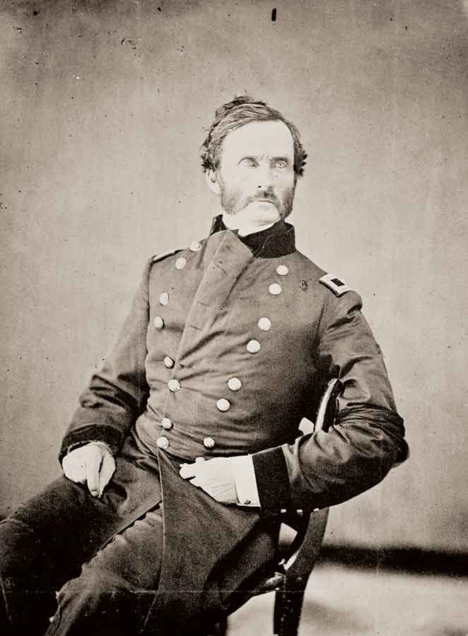
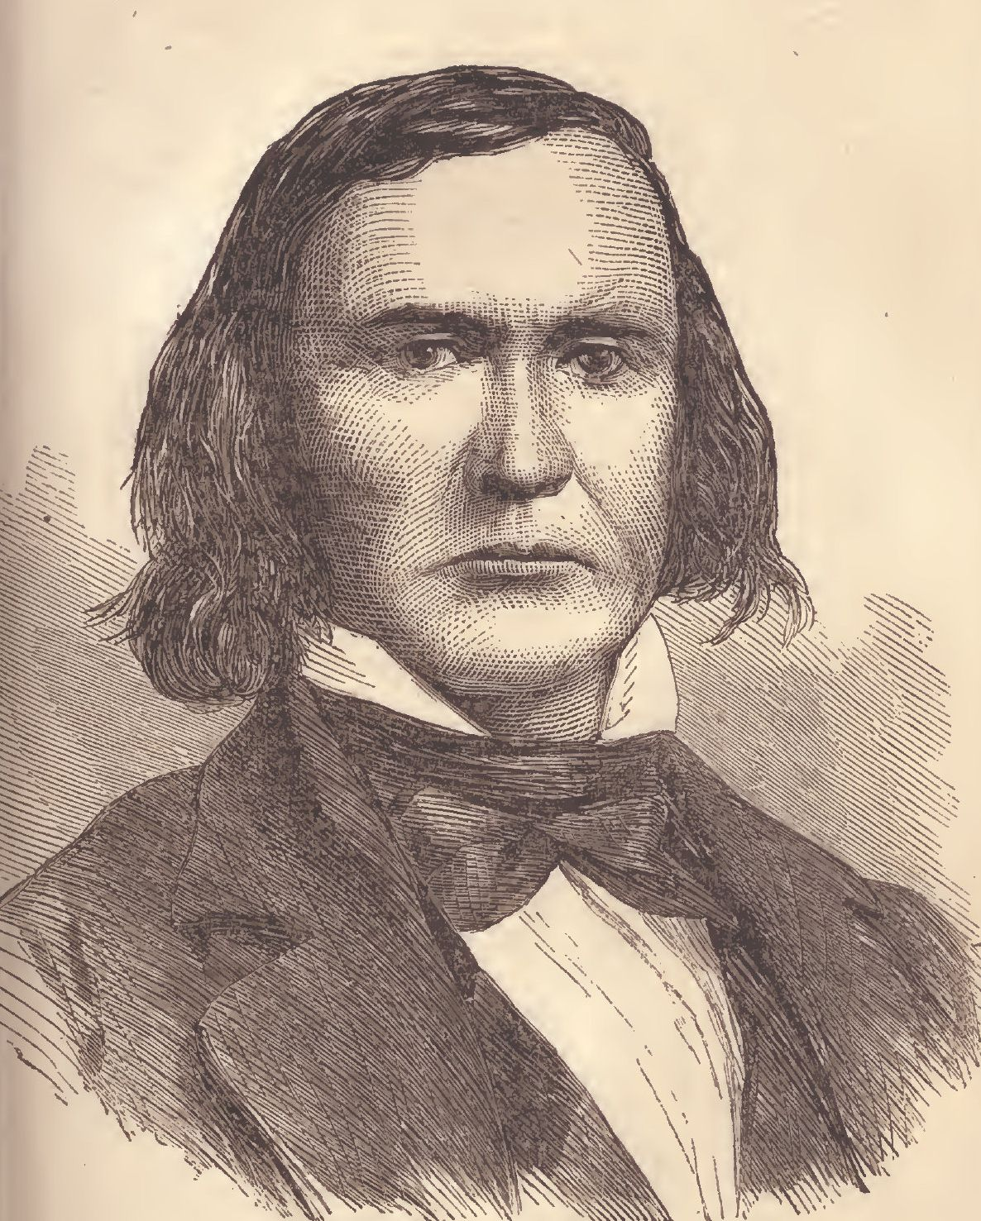
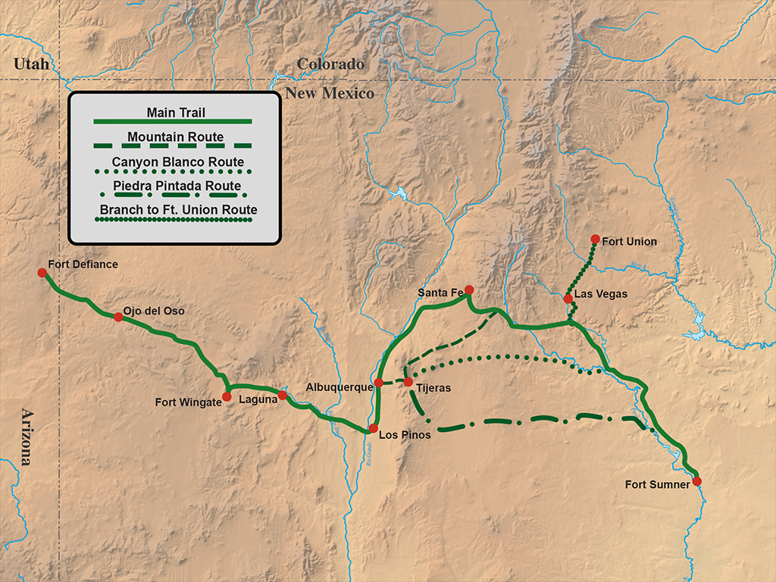
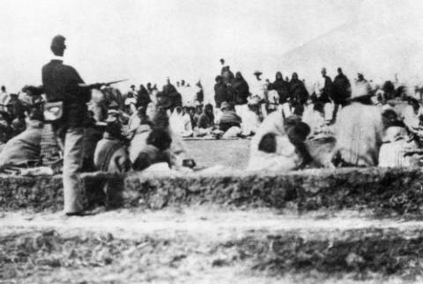
War in the West: The immediate and lasting effects of the conflicts between the Navajo and the U.S. in the mid-19th century. Christian Sherman and Josh Layton
Introduction:
In the early 1800s, the institution of manifest destiny ideals had already been in motion for quite some time, and most Americans believed in the idea that the borders of the United States were meant to stretch from the Atlantic to the Pacific. This meant that for many years amidst this progress, the United States government was faced with coming up with solutions for the inevitably-viewed conflicts with Native peoples indigenous to western lands. One such group of people were the Navajo. As the American military moved further and further west, they inevitably crossed paths with the Navajo people. In 1851 Fort Defiance was built on Navajo land, which prompted a series of raids and violent actions back and forth from either side until a treaty was signed in 1855. After the treaty however, relations were tense between the two sides and the Navajo began enduring a period of devastating drought and famine. After the American soldiers refused to offer substantial relief, and more significant disagreements again led to violence, a military campaign was launched against the Navajo in 1860. After a three-year period of constant conflict, General James Henry Carleton ordered Navajo leaders to surrender and relocate to the Bosque Redondo reservation at Fort Sumner. Simultaneously, he commissioned Kit Carson to lead a violent expedition against the Navajo, forcing their relocation while destroying their homes, burning their fields and killing their livestock. In 1863 the Navajo endured the great Long Walk migration to the Bosque Redondo. Many Navajo died from the harsh and unforgiving conditions of the journey.
Witness accounts:
· “The exodus of this whole people from the land of their fathers is a touching sight. They have fought us gallantly for years on years; they have defended their mountains and their stupendous canyons with heroism; but at length, they found it was their destiny, too, to give way to the insatiable progress of our race.” Gen. James Carleton. (5)
· “Most of the people got sick and had stomach trouble. The children also had stomach ache. The prisoners begged the Army for some corn, and the leaders also pleaded for it for their people. Finally, they were given some- one ear of corn each.” Navajo Survivor of Bosque Redondo. (6)
· My God and my mother live in the west and I will not leave them. I was born there. I shall remain there. I have nothing to lose but my life, and that they can come take whenever they please. But I will not move.” Manuelito, Navajo. (6)
Contrasting perspectives:
“General Carleton ordered his soldiers to treat their charges with “Christian kindness”-and reminded them that the goal was to transport them to Bosque Redondo as swiftly and safely as possible so that soldiers would never have to fight them again…The Navajos, Carleton said, were now ‘proteges of the United States -a people who, having given up their country, should be provided for by a powerful and Christian nation.’” (5)
“Families living in and around the canyon were rousted from their adobe-covered hogans, which were then burned- along with their saddles, clothing, and blankets. Their sheep, cattle, and horses were seized or slaughtered, their peach orchards were hacked down, and about 2 million pounds of Navajo corn went up in smoke. Families hiding in the canyon walls were hunted down. Tribal accounts tell of some who chose to leap from the cliffs rather than leave their homeland.” (6)
Wikipedia.org
Historynet.com
Accessgeneology.com
Research Question: What were the negative impacts of the wars between the United States and the Navajo peoples on Navajo way of life and how have they had a lasting impact on today’s Navajo?
Immediate effects:
· The arrival of Fort Defiance on a good portion of Navajo land led to a time of hardship for the Navajo and continuous conflicts between Navajo and U.S. soldiers. Many Navajo were upset that the American soldiers took prime land that the Navajo desperately needed as a time of drought and famine ensued.
· Carson’s campaign came after a time of struggling for the Navajo during the occupation of Fort Defiance and devastated Navajo communities. General Carleton’s intentions in the forced migration were to force the Navajo to abandon their traditional way of life and assimilate into American culture.
· Most Navajo were not at all equipped to endure the harsh conditions of the Long Walk migration. They lacked proper clothing, shelter, and food. About 110 Navajo died from the journey alone.
· As the Navajo were forced to relocate, the Carson-led American military destroyed Navajo villages. Hogans, which served as living space and also had religious and cultural significance, were burned and destroyed. Navajo livestock was killed, and U.S. soldiers chased Navajo people to ensure they left their homes for the Bosque Redondo.
· Because of his Navajo campaign and his many other conflicts with Native people, Carson built a reputation of embodying American patriotism and heroism during the spread of Manifest Destiny. General Carleton most likely never saw the events of the Long Walk.
Lasting effects:
· In the 1930s, the Bureau of Indian Affairs enacted policies that forced Navajo to reduce their livestock population. The goal of these policies were to encourage Navajo to seek work outside the reservation, become wage workers, and leave reservation life to become nuclear families in American communities.
· Instead of seeing wage working as an opportunity for a new way of life, Navajo workers resisted abandoning their traditions, and used work off the reservation to support their families.
· Because Navajo workers spent significant time away from the reservation, they were forced to negotiate between culturally-defined perceptions of work, gender role, and household responsibility. This caused a dramatic shift overtime in Navajo culture and communities.
· The BIA’s intentions were similar to general Carleton’s seventy years prior. Both wanted to force the Navajo to adapt to American culture and move away from their traditions. Ironically, Carleton tried to accomplish the by forcing the Navajo into a reservation, and the BIA tried to do the same by forcing them out of one.
· The Navajo Nation is the second largest Native American tribe in the US behind the Cherokee and the largest reservation by size in the US. However, over 40% over of the reservation lack access to running water. Many live in extreme poverty, and are unable to purchase large containers to store clean water in. Most have to rely on volunteer/humanitarian/charitable organizations for water, which is delivered by trucks from the outside the reservation (2). Those who are not assisted in this way, have to rely on the kindness of neighbors and loved ones (1).
Mytext.cnm.edu
1858 Navajo demand that Fort Defiance stop grazing livestock on Navajo land
1864-1866 The Long Walk Migration
1851 Edwin Sumner’s campaign against the Navajo
1861 Treaty at Fort Fauntleroy
Sources:
Lazaro, Fred De Sam. "How Off-the-grid Navajo Residents Are Getting Running
Water." PBS. June 20, 2018. Accessed April 08, 2019. https://www.pbs.org/newshour/show/how-off-the-grid-navajo-residents-are- getting-running-water.
2. "Navajo Reservation - Navajo Relief Fund." A Program of Partnership With Native Americans. Accessed April 08, 2019. http://www.nativepartnership.org/site/PageServer?pagename=nrf_navajoreservat ion.
3. "Navajo Wars." Wikipedia. December 22, 2018. Accessed April 08, 2019. https://en.wikipedia.org/wiki/Navajo_Wars.
4. Nichols, Roger L. The American Indian: Past and Present. Norman, OK: University of Oklahoma Press, 2008.
5. Sides, Hampton. Blood and Thunder: An Epic of the American West. London: Abacus, 2008.
6. Through Indian Eyes: The Untold Story of Native American Peoples. Pleasantville, N.Y: Readers Digest Association, 1996.
Conclusion:
The forced removal of the Navajo and other Native Americans by the U.S. military in the mid-19th century has caused a chain of events that has led to the abandonment of traditional Navajo culture and has harshly impacted sense of community and quality of life or Navajo peoples.
1855 Treaty between Manuelito and U.S. Officials
1860 Second Battle of Fort Defiance
1863 Beginning of the Kit Carson campaign

