Slide 1
Outsiders in the Liminal World of Young Adulthood
Fiction That Cultivates Empathy and Activism

Slide 2
From My Proposal/Abstract
With The Outsiders, Sue Hinton named a category of fiction for young readers. For fifty years, Young Adult literature has focused on out-groups and in-groups, as authors have showcased the experiences of children marginalized by socioeconomic factors, war, tragedy, family circumstances, and/or identity issues just as they are entering into the rites of passage that mark their paths to adulthood. . . . YA literature has long been an arena for narratives that challenge the dominant cultural narratives of growing up, developing one’s identity, and finding love.
Notes:
Date contemporary YA to 1967 (not Seventeenth Summer or The Catcher in the Rye)

Slide 3
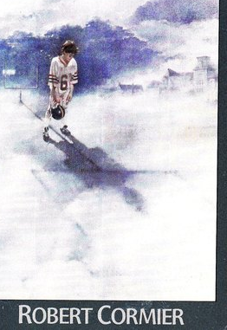
“Do I Dare Disturb the Universe?”
The Chocolate War by Robert Cormier (1974)
“They murdered him.”
“The shadows of the goal posts sprawled on the field like grotesque crosses”
Notes:
The question, the cover design, the Vigils, Brother Leon--defeat

Slide 4
Titles in My Proposal: A List of Outsiders
The Outsiders by S. E. Hinton (1967)
The Contender by Robert Lipsyte (1967)
A Hero Ain’t Nothin’ But a Sandwich by Alice Childress (1973)
M. C. Higgins, the Great by Virginia Hamilton (1974)
Homecoming by Cynthia Voigt (1981)
Annie on My Mind by Nancy Garden (1982)
The Giver by Lois Lowry (1993)
Monster by Walter Dean Myers (1999)
The Book Thief by Marcus Zusak (2005)
The Hunger Games by Suzanne Collins (2008)
Aristotle and Dante Discover the Secrets of the Universe by Benjamin Alire Sáenz (2012)
Bone Gap by Laura Ruby (2015)
Out of Darkness by Ashley Hope Pérez (2015)
The Hate U Give by Angie Thomas (2017)
Notes:
Ponyboy, Alfred, Benjie, M.C. Higgins, Dicey, Liz & Annie, Jonas, Steve, Liesel, Katniss

Slide 5
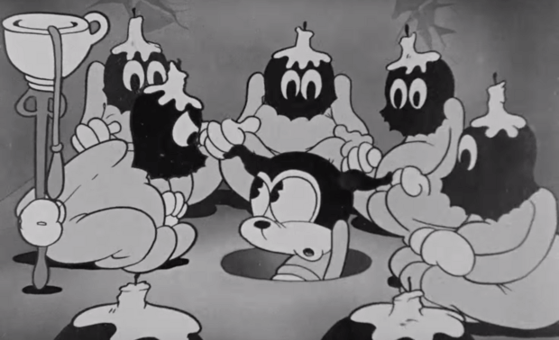
Liminality: Threshold Experiences
Developed by anthropologist Victor Turner: rites of passage & ceremonies of initiation
Built on the 3-stage process described by folklorist Arnold Van Gennep:
1. Separation
2. Marginal phase, limen
3. Re-aggregation within community in new role

Slide 6
The Transformative Phase, an Ordeal
Initiates undergo a “grinding down process” through “ordeals” that may include
“impossible physical tests in which failure is greeted by ridicule” (Turner 37).
Rebuilding process develops initiate’s new identity through instruction in “practical skills” and “tribal esoterica,” often coming from masked figures (Turner 38).
The “’liminaries’” are “provok[ed] . . . into thinking hard about the elements and basic building blocks of symbolic complexes they had hitherto taken for granted as ‘natural’ units” (Turner 38).
Notes:
This fits The Chocolate War—but Jerry doesn’t win.

Slide 7
I propose:
. . . these novels and others invite readers to identify and empathize with marginalized members of their societies. This focus on a liminal phase of life and protagonists’ increasing independence allow young readers to question adult characters’ assumptions and practices and act to alter their world in ways that let them thrive.

Slide 8
Does reading “literary fiction” promote empathy in readers?
The study: David Kidd & Emmanuelle Castano, Science, 2013
Immediate increase in empathy: causal relationship
Comparison of literary fiction with other texts
Randomly assigned participants
Theory-of-mind instrument RMET

Slide 9
The Background for a Review of the Research
Maria Eugenia Panero, Deena Skolnick Weisberg, Jessica Black, Thalia R. Goldstein, Jennifer L. Barnes, Hiram Brownell, and Ellen Winner. “Does Reading a Single Passage of Literary Fiction Really Improve Theory of Mind? An Attempt at Replication.” Journal of Personality and Social Psychology, 2016.
“Exercising one’s mindreading capacities in the context of fictional stories, which tend to focus on interpersonal relationships and psychological states, could lead one to become more empathetic and skilled at mindreading (Keen, 2007; Nussbaum, 2003; Oatley, 2012; Zunshine, 2006).”
“Correlational studies support this argument: Lifetime engagement with fiction, as measured by the Author Recognition Test (ART; Acheson, Wells, & MacDonald, 2008; Stanovich & West, 1989), is positively related to theory of mind, as measured by the Reading the Mind in the Eyes Test (RMET; Baron-Cohen, Wheelwright, Hill, Raste, & Plumb, 2001), which tests the ability to recognize mental states from photos of a person’s eyes (Djikic, Oatley, & Moldoveanu, 2013; Mar, Oatley, Hirsh, dela Paz, & Peterson, 2006; Mar, Oatley, & Peterson, 2009).”
“There is also neural evidence for this connection: Brain areas activated during theory-of-mind tasks are also activated while processing fictional stories (Mar, 2011).”

Slide 10
Conclusions from this line of research?
Panero et al. found conflicting results from research subsequent to Kidd and Castano’s: “. . . the effect may depend on how an individual engages with the specific texts.”
“Reading Literature Won’t Give You Superpowers” by Joseph Frankel, The Atlantic, 2016:
The media’s response to Kidd and Castano: “Along with raising objections from the authors of the original study, this newer paper is a reminder of the way reporting can reshape scientific ideas. Most popular coverage of the original study talked about this work in terms of ’empathy,’ but the researchers themselves say that’s not quite the same thing as theory of mind.”
The need for scientific, quantifiable justification for teaching literature? Budgets?
Nuances: Time spent with texts? Defining “literary”? Does empathy translate into action?

Slide 11
Hearing from Students
“The theme of biculturalism appears very often in young adult literature and is the guiding theme for the books previously discussed. It seems that the overarching purpose of young adult literature is to allow the reader to connect to the characters in some way. If not through their experiences, the reader can find themselves in the problems that the characters face. There are many challenges that these characters must deal with, but one of the major challenges is adjusting to a new culture in order to seek new opportunities. Many characters face the difficult task of losing their identity because of oppression or the search for a better life in place of their own. It is because of these struggles that young adults can better understand what life is like for those of a different culture and seek to be more aware of the things that are happening all around them. It also allows readers who have gone through similar experiences to find within themselves the same courage and bravery as many of the characters they read about.”
—first-year student in Literature for YAs, April 2018

Slide 12
Where next?
Spontaneous (unprompted) comments in presentations Spring 2018 & Spring 2019:
”I never realized . . .”
“I never thought about . . .”
“I never understood . . .”
Future research in classes
Spring 2019 assignment
More intentional data-gathering

Slide 13
Victimization vs. Activism

Slide 14
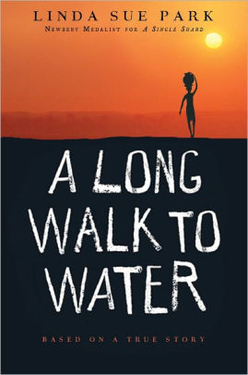
A Long Walk to Water by Linda Sue Park (2010)
Water for South Sudan: https://www.waterforsouthsudan.org/
Celebrating 15 years: 349 wells serving 300,000 people
Google news about the organization and the book for recent updates—kids in Minnesota, South Dakota, Rockingham County . . .
“Can a Children’s Book Change the World?” by Linda Sue Park—TEDxBeaconStreet on YouTube at https://www.youtube.com/watch?v=40xz0afCjnM: “hope, righteous anger, determination”

